Slide 1
Chapter 2

Slide 2
Objectives

Slide 3
Objectives (continued)

Slide 4
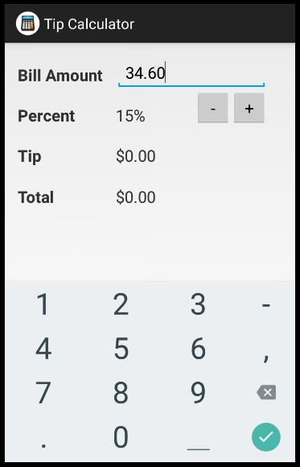
The user interface for the Tip Calculator
EditText widget (editable text view)
Button widget (button)
TextView widget (text view)

Slide 5
How to create a new project

Slide 6
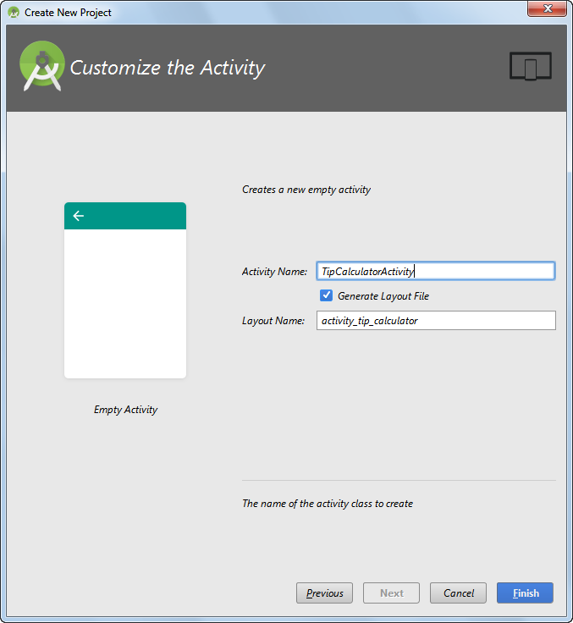
The New Android Application dialog box

Slide 7
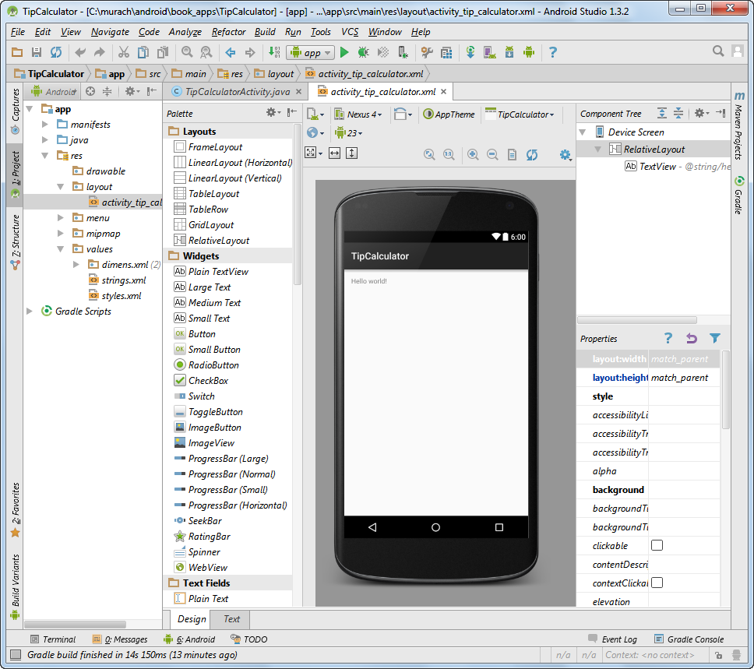
The default layout for an activity in a new project

Slide 8
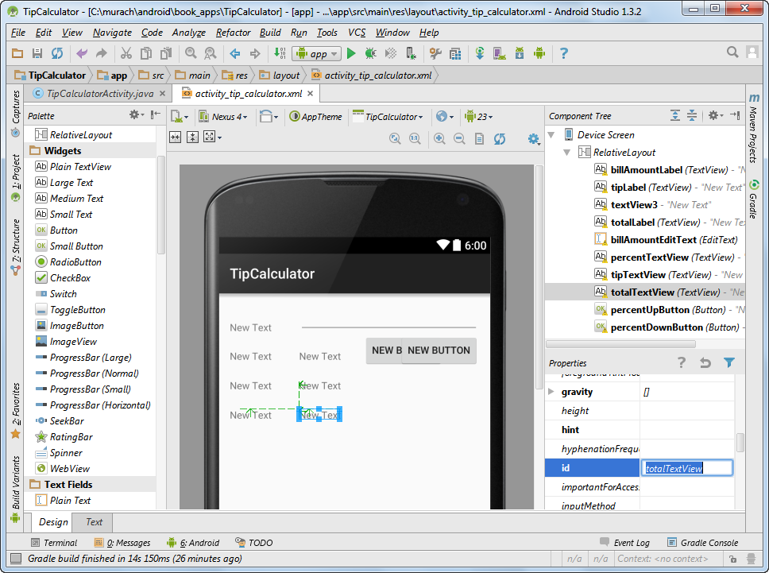
A layout after some widgets have been added to it

Slide 9
How to add, remove, and align widgets

Slide 10
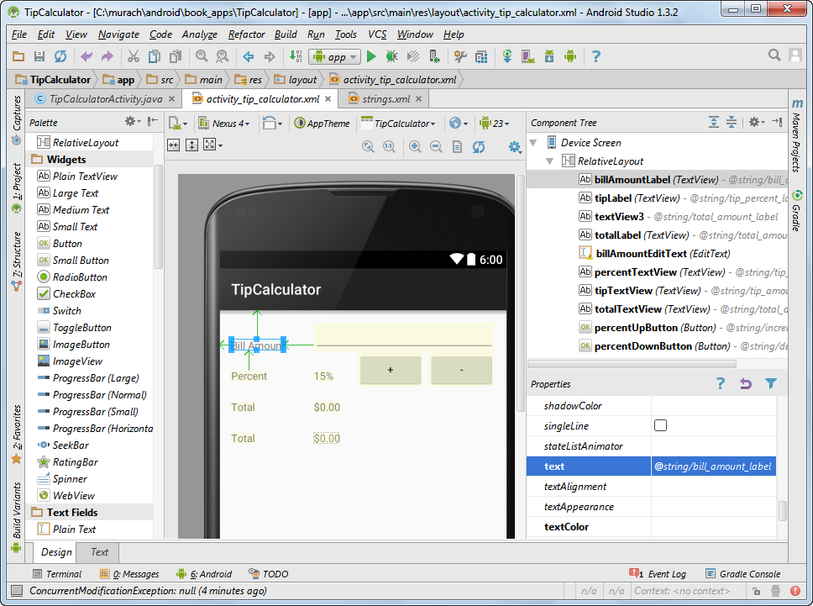
A layout after the text has been set for the widgets

Slide 11
How to set the text property for a widget

Slide 12
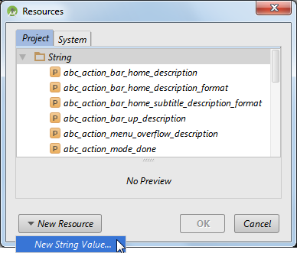
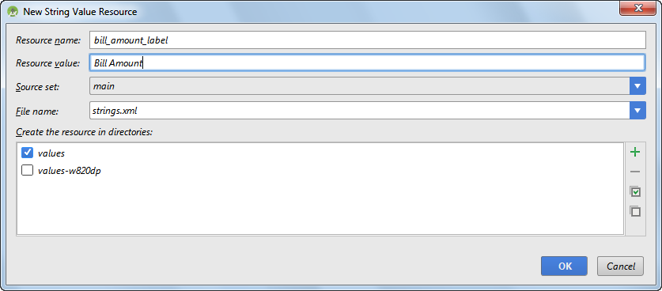
Two dialog boxes for setting text

Slide 13
The strings.xml file for the Tip Calculator app

Slide 14
The location of a strings.xml file for France

Slide 15
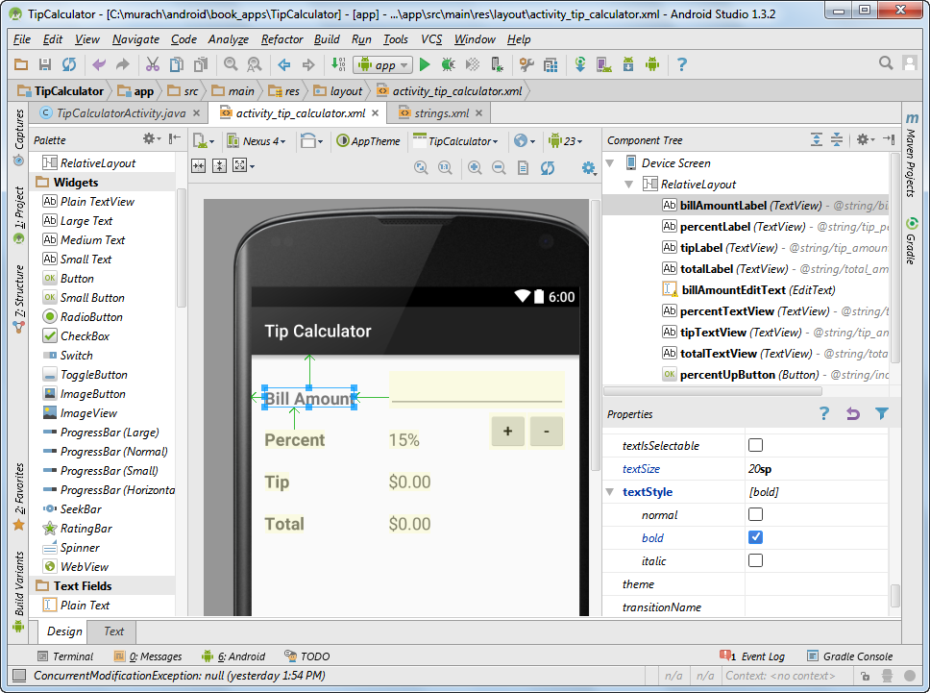
A layout after some properties have been set

Slide 16
Common properties for layouts

Slide 17
Common properties for widgets

Slide 18
Pre-defined values for setting height and width

Slide 19
The XML for the user interface

Slide 20
The XML for the user interface (continued)

Slide 21
The XML for the user interface (continued)

Slide 22
The XML for the user interface (continued)

Slide 23
The XML for the user interface (continued)

Slide 24
The XML for the user interface (continued)

